Slide 1
Did you know that powerpoint is turing complete?

Slide 2
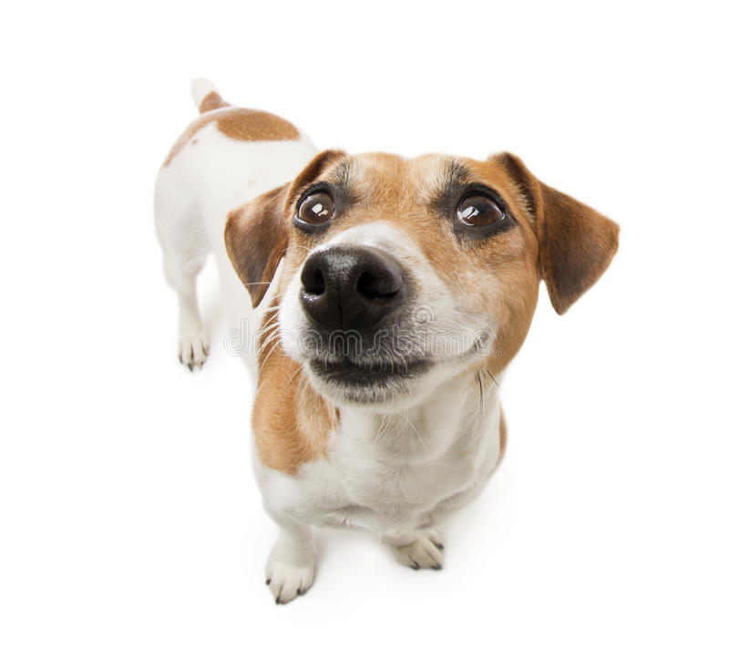
Do you pet the dog?

Slide 3
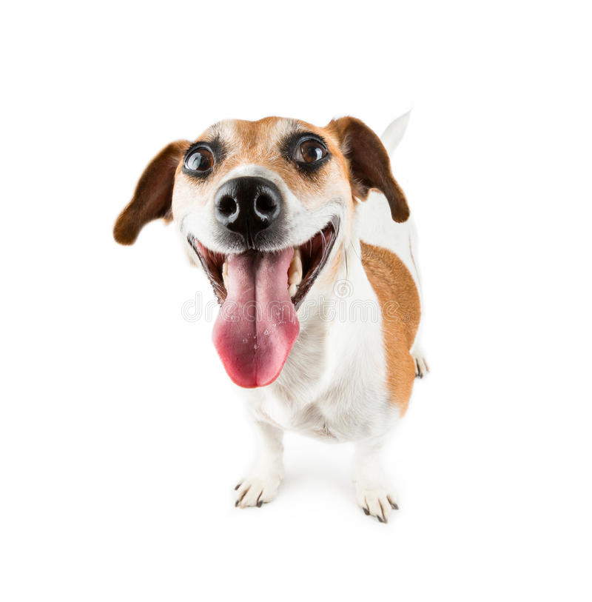
The dog understands if you dont

Slide 4
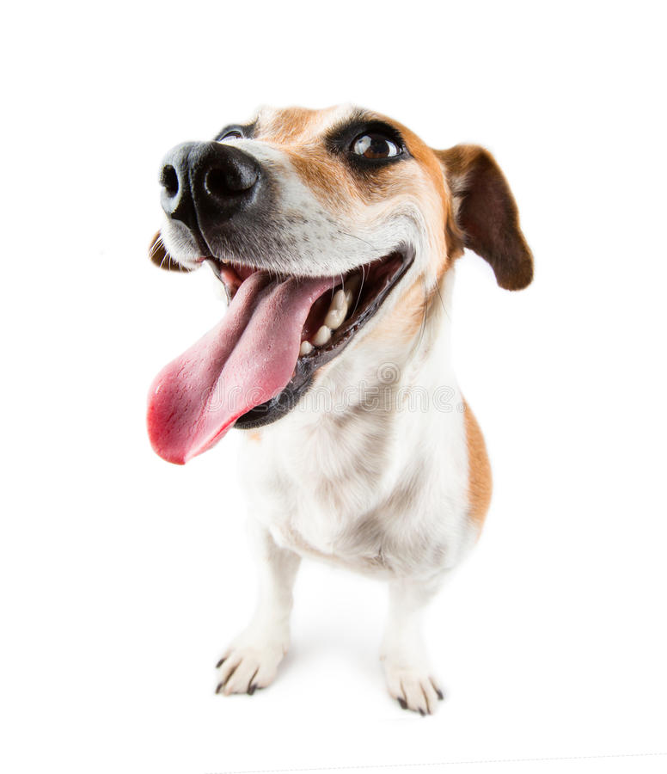
The dog is happy! (Redo?)

